Slide 1

Title of Project: Healthcare Chatbot (Frontend + Gemini API Integration)
JSPM’s
Rajarshi Shahu College of Engineering, Tathawade, Pune
(An Empower Autonomous Institute under Savitribai Phule Pune University)
Department of Computer Science and Business Systems
Artificial Intelligence Mini Project
AY-2025-26
Student Name:
  Prathmesh Masule
  Mayur Rathod
Faculty Name:

Slide 2
Introduction
Objective of the Project:
Scope:
  The system provides AI-based first aid and health guidance to patients and rural health workers through an interactive chatbot.
  It demonstrates frontend–Gemini API integration to deliver accurate, real-time healthcare responses in a simple and accessible interface.
Mapping With SDG Goal: SDG 3 – Good Health and Well-Being
  Promotes healthy lives and ensures well-being for all by providing accessible healthcare guidance.
Key Features:
  AI-Powered Responses: Uses Gemini API to provide accurate and context-aware health advice.
  User-Friendly Frontend: Built with HTML, CSS, and JavaScript for smooth and responsive interaction.
  Multilingual Support: Allows users to ask questions in regional languages for better accessibility
  Real-time answer feedback (green = correct, red = incorrect).
To provide instant, AI-based healthcare assistance to users.
To build a responsive, user-friendly frontend for real-time interaction.
To integrate Google Gemini API for intelligent, context-aware health responses.
To support regional languages and offline mode for rural accessibility.
To ensure data privacy and ethical AI use in health communication.

Slide 3
Algorithm Used
Algorithm: Google Gemini API (Generative AI Model)
Why Gemini API?
Provides contextual and human-like answers for health-related queries.
Handles natural language processing efficiently.
Can be customized for medical or educational datasets.
Fast and scalable integration using REST APIs.
Advantages:
Instant AI-driven responses
Reduces human workload in basic health consultation
Easy integration with frontend via REST API

Slide 4
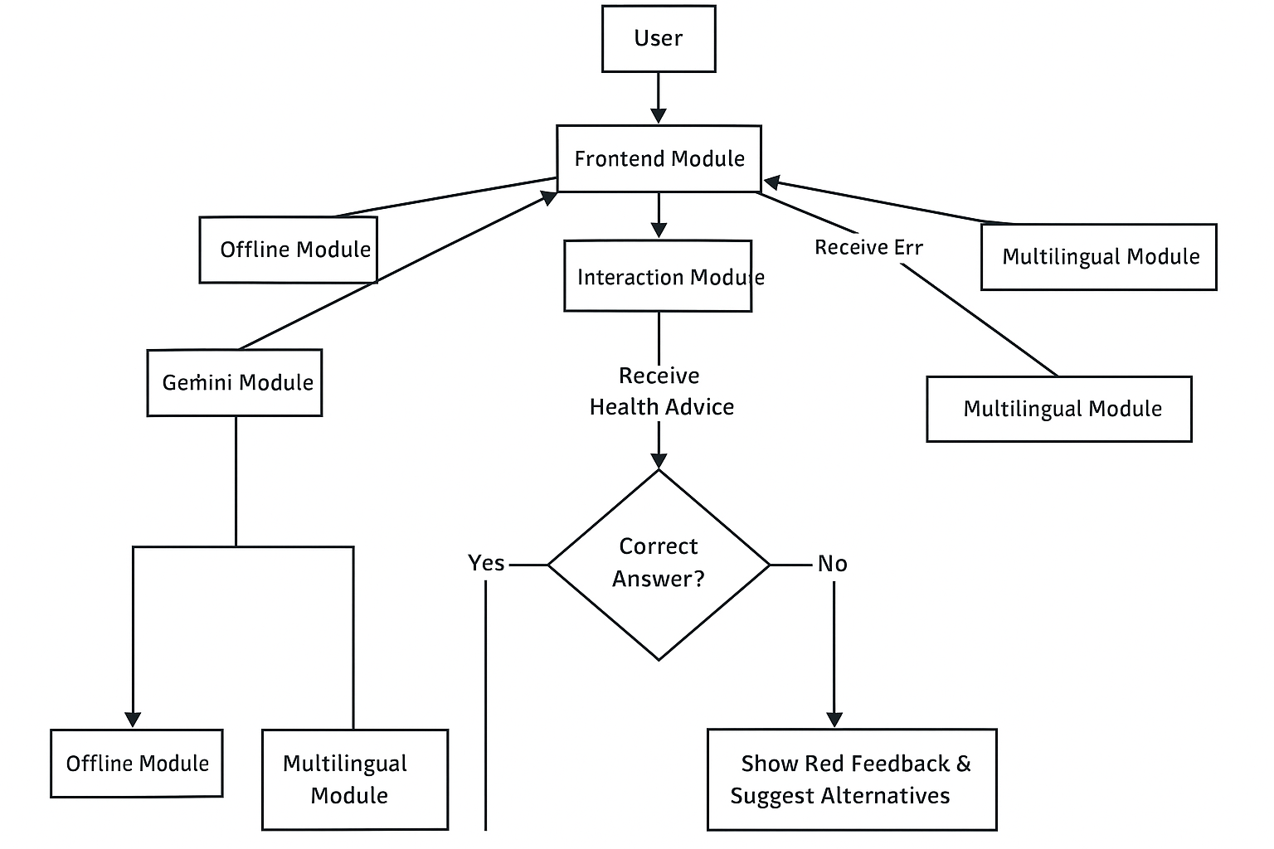
Module

Slide 5
Methodology & Results
Methodology:
  Problem analysis: Identified the need for instant, reliable health support for rural users.
  2. Algorithm design & coding:
    Designed the frontend using HTML, CSS, and JavaScript.
    Integrated the backend API with Gemini for AI-driven question generation.
    Added validation and error-handling features
  3. Testing & validation:
    Tested on different health queries.
    Ensured accurate, safe, and meaningful responses.
Results & Conclusion:
The chatbot successfully responds to general health queries.
Provides accurate, AI-generated first-aid and health advice.
Demonstrated effective frontend and Gemini API integration.

Slide 6
References
W3Schools – HTML, CSS, and JavaScript basics for frontend design.
MDN Web Docs – Fetch API and DOM manipulation for API handling.
Google Gemini API Documentation – for generative AI integration.
WHO Guidelines – for verified first-aid and health information.

